Slide 1
Class Relationships
Review

Slide 2
What are classes?
A class describes a group of objects with
similar properties (attributes),
common behaviour (operations),
common relationships to other objects,
and common meaning (“semantics”).
Examples
Employee: has a name, employee# and department; an employee is hired, and fired; an employee works in one or more projects
Employee
Name (mandatory)
Attributes
(optional)
name
employee#
department
hire()
fire()
assignproject()
Operations
(optional)
2

Slide 3
Objects vs. Classes
The instances of a class are called objects.
Objects are represented as:
The relation between an Object and its Class is called “Instantiation”
Two different objects may have identical attribute values (like two people with identical name and address)
Note: Make sure attributes are associated with the right class
E.g. you don’t want both managerName and manager# as attributes of Project! (…Why??)
Fred_Bloggs:Employee
name: Fred Bloggs
Employee #: 234609234
Department: Marketing
3

Slide 4
Relationships
Objects do not exist in isolation from one another
A relationship represents a connection among things.
E.g. Fred_Bloggs:employee is associated with the KillerApp:project object
But we will capture these relationships at the class level (why?)
Class diagrams show classes and their relationships
In UML, there are different types of relationships:
Association
Aggregation and Composition
Generalization
Dependency
Realization
4

Slide 5
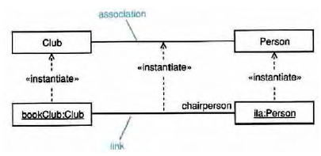
Association
Associations are semantic connections between classes.
If there is a link between two objects, there must be an association between the classes of those objects.
Links are instances of associations just as objects are instances of classes.
Association
Link
5

Slide 6
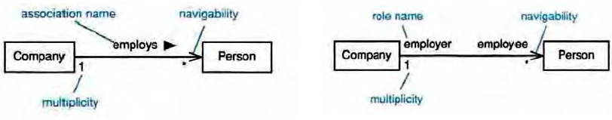
Association
Associations may optionally have the following:
Association name
may be prefixed or postfixed with a small black arrowhead to indicate the direction in which the name should be read;
should be a verb or verb phrase;
Role names
on one or both association ends;
should be a noun or noun phrase describing the semantics of the role;
Multiplicity
The number of objects that can participate in an instantiated relation
Navigability
Association name
navigability
role name
navigability
*
*
multiplicity
multiplicity
6

Slide 7
Association Multiplicity
Ask questions about the associations:
Can a company exist without any employee?
If yes, then the association is optional at the Employee end - zero or more (0..*)
If no, then it is not optional - one or more (1..*)
If it must have only one employee - exactly one (1)
What about the other end of the association?
Can an employee work for more than one company?
No. So the correct multiplicity is one.
Some examples of specifying multiplicity:
Optional (0 or 1) 0..1
Exactly one 1 = 1..1
Zero or more 0..* = *
One or more 1..*
A range of values 2..6
Company
1
0 .. *
Employee
7

Slide 8
Class associations
Multiplicity
A client has exactly one staffmember
as a contact person
Multiplicity
A staff member has zero or more clients on
His/her clientList
Name of the
association
:Client
:StaffMember
companyAddress
companyEmail
companyFax
companyName
companyTelephone
staffName
staff#
staffStartDate
1
liaises with
0..*
contact
person
ClientList
Direction
The “liaises with”
association should be
read in this direction
Role
The staffmember’s role in this association is as a contact person
Role
The clients’ role in this association is as a clientList
8

Slide 9
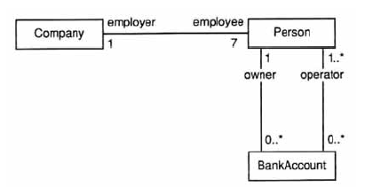
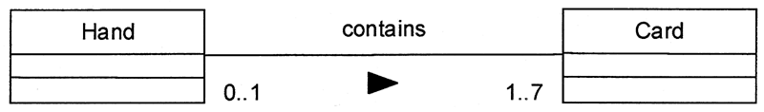
More Examples
9

Slide 10
Navigability / Visibility
Order
+ dateReceived: Date [0..1]
+ isPrepaid: Boolean [1]
+ lineItems: OrderLine [*] {ordered}
Date
0..1
*
Order
1
Boolean
+dateReceived
+isPrepaid
1
*
+lineItems {ordered}
OrderLine
10

Slide 11
Bidirectional Associations
Person
0..1
*
Car
How implement it?
Person
+ carsOwned: Car [*]
Car
+ Owner: Person [0..1]
Implementation Complexities !
11

Slide 12
Generalization
Generalization is a relationship between a more general thing and a more specific thing:
the more specific thing is consistent in every way with the more general thing.
the substitutability principle states that you can substitute the more specific thing anywhere the more general thing is expected.

Slide 13
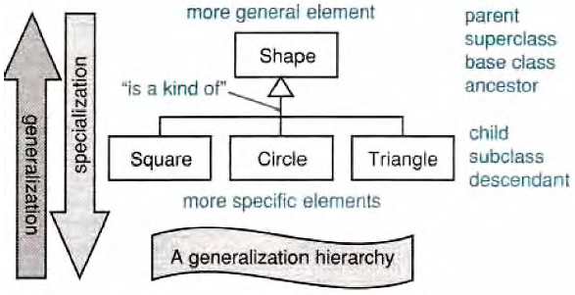
Generalization/Specialization
Generalization hierarchies may be created by generalizing from specific things or by specializing from general things.
More general element
Parent
Superclass
Ancestor
Base Class
“is a kind of”
Child
Subclass
Descendant
Leaf
More specific element

Slide 14
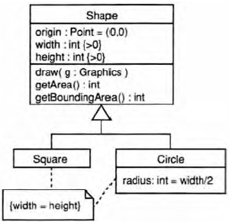
Inheritance
Class inheritance is implicit in a generalization relationship between classes.
Subclasses inherit attributes, associations, & operations from the superclass
What is the inheritance mechanism in Java?

Slide 15
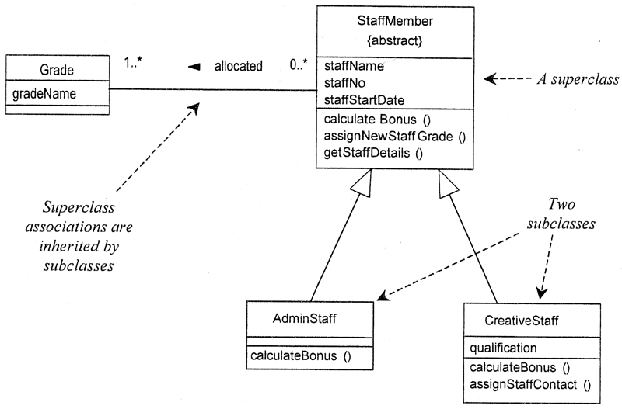
Inheritance
Prefer to have object of Grade as Attribute of StaffMember
Notes:
A subclass may override an inherited aspect
e.g. AdminStaff & CreativeStaff have different methods for calculating bonuses
A Subclass may add new features
qualification is a new attribute in CreativeStaff
Superclasses may be declared {abstract}, meaning they have no instances
Implies that the subclasses cover all possibilities
e.g. there are no other staff than AdminStaff and CreativeStaff

Slide 16
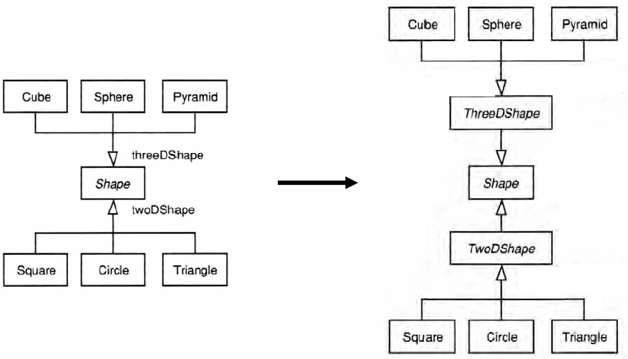
Generalization Sets: Implementation

Slide 17
Aggregation and Composition
Aggregation
This is the “Has-a” or “Whole/part” relationship
aggregation
Club
Member
*
*
:Car
:Train
0..1
:Person
0..1
0..*
driver
1
passengers
aggregation
17

Slide 18
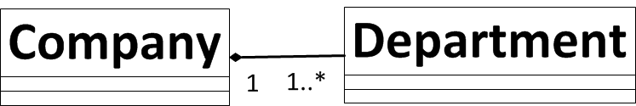
Aggregation and Composition
Aggregation
This is the “Has-a” or “Whole/part” relationship
Composition
Strong form of aggregation that implies ownership:
if the whole is removed from the model, so is the part.
the whole is responsible for the disposition of its parts
Note: Parts can be removed from the composite (where allowed) before the composite is deleted
Polygon
{ordered}
Point
centre
Circle
3..*
1
Note: No sharing - any instance of point can be part of a polygon or a circle, but not both (Why?)
18
18

Slide 19
Aggregation and Composition
1
:Engine
composition
:Locomotive
1..*
1
0..1
:Car
:Train
0..1
:Person
0..1
0..*
driver
1
passengers
aggregation
19

Slide 20
Class Activity
Draw the UML class diagram which represents a file system – containing files and directories

Slide 21
Dependency
Dependencies are relationships in which a change to the supplier affects, or supplies information to, the client.
The client depends on the supplier in some way.
Dependencies are drawn as a dashed arrow from client to supplier.
Model
View
ViewController
Layout

Slide 22
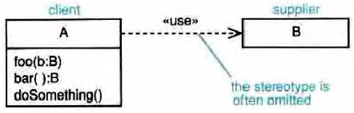
Usage Dependencies
«use»-the client makes use of the supplier in some way -this is the catch-all.
«call»-the client operation invokes the supplier operation.
«parameter»-the supplier is a parameter or return value from one of the client's operations.
«instantiate»-the client is an instance of the supplier.
client
Supplier
The stereotype is often omitted

Slide 23
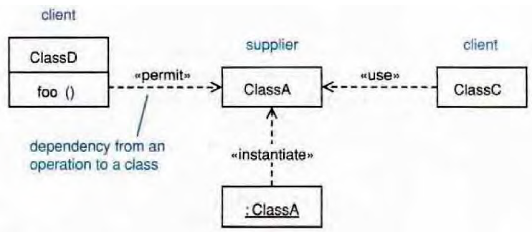
Dependencies: Example
client
Supplier
client
<<call>>
<<use>>
Dependency from an operation to a class
<<instantiate>>
Example Dependency types:
<<call>>
<<use>>
<<create>>
<<derive>>
<<instantiate>>
<<permit>>
<<realize>>
<<refine>>
<<substitute>>
<<parameter>>

Slide 24
Interfaces
<<interface>>
Collection
equals
add
Order
LineItems [*]
<<interface>>
List
get
<<realizes>>
ArrayList
get
add
<<requires>>
Required interfaces
Provided interfaces
Collection
Order
LineItems [*]
List
ArrayList
Notes:
There are classes that have nothing but pure virtual (abstract) functions. In Java such entities are not classes
at all; they are a special language element called an interface. UML has followed the Java
example and has created some special syntactic elements for such entities.

Slide 25
Annotation
Comments
-- can be used to add comments within a class description
Notes
Constraint Rules
Any further constraints {in curly braces}
e.g. {time limit: length must not be more than three months}
Date Range
Start: Date
End: Date
/length: integer
{length = start - end}
25

Slide 26
What UML class diagrams can show
Division of Responsibility
Operations that objects are responsible for providing
Subclassing
Inheritance, generalization
Navigability / Visibility
When objects need to know about other objects to call their operations
Aggregation / Composition
When objects are part of other objects
Dependencies
When changing the design of a class will affect other classes
Interfaces
Used to reduce coupling between objects
26

